Slide 1

CoPilot Safe Assist
Software Engineering 2: Project Teamwork Mälardalen University
Optimus Octavian

Slide 2

The problem

Slide 3




Client
Problem
Construction Equipment
Accidents at construction sites

Slide 4

The members

Slide 5
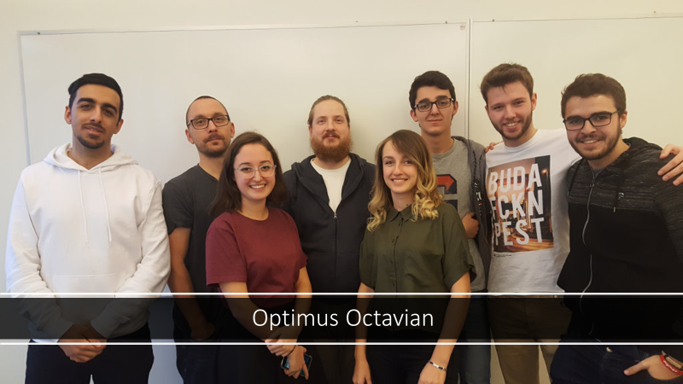

Slide 6














Slide 7
Dara

Slide 8
Rickard

Slide 9
Vasja

Slide 10
Jonas

Slide 11
Sidorela

Slide 12
Fernando

Slide 13
Pablo

Slide 14
Alvaro

Slide 15
Tasks!
Álvaro - Notetaker
Dara - Presentation Overseer
Fernando - Conﬁguration Manager (Android Studio)
Jonas - Presentation Overseer
Pablo - Conﬁguration Manager (Trello)
Rickard - Conﬁguration Manager (GIT)
Sidorela - Client Contact, Documentation
Vasja - Group Manager

Slide 16

Communication

Slide 17







Slide 18

Wednesday
Working group meeting
Friday
Big group meeting
Monday
Steering group meeting
Weekend

Slide 19
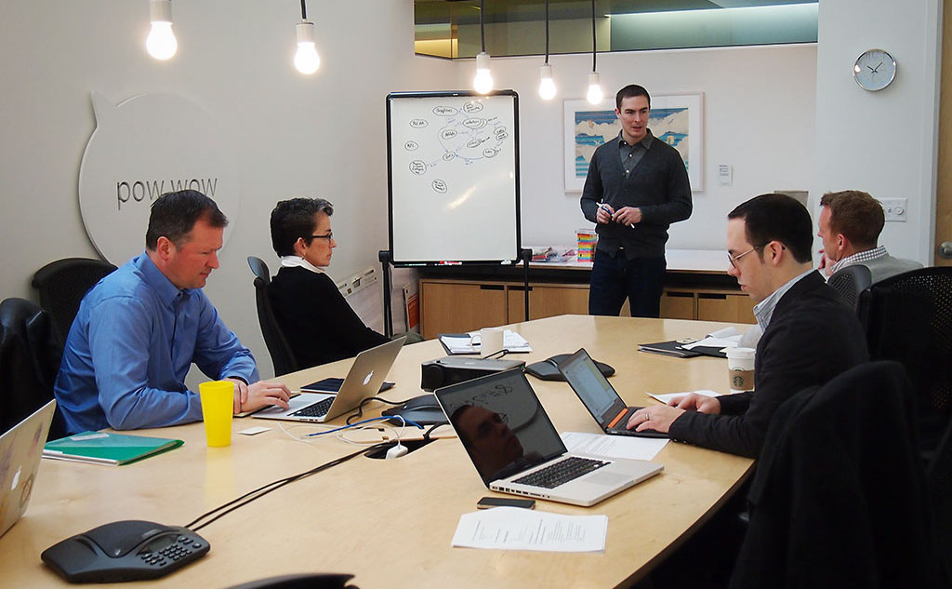
Client meeting

Slide 20


Client meeting
Much cars
Such Volvo
WoW

Slide 21

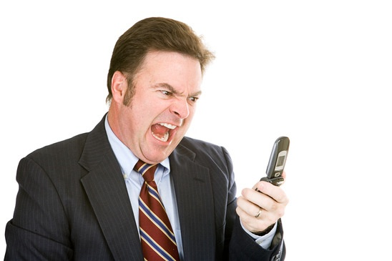
Client meeting

Slide 22

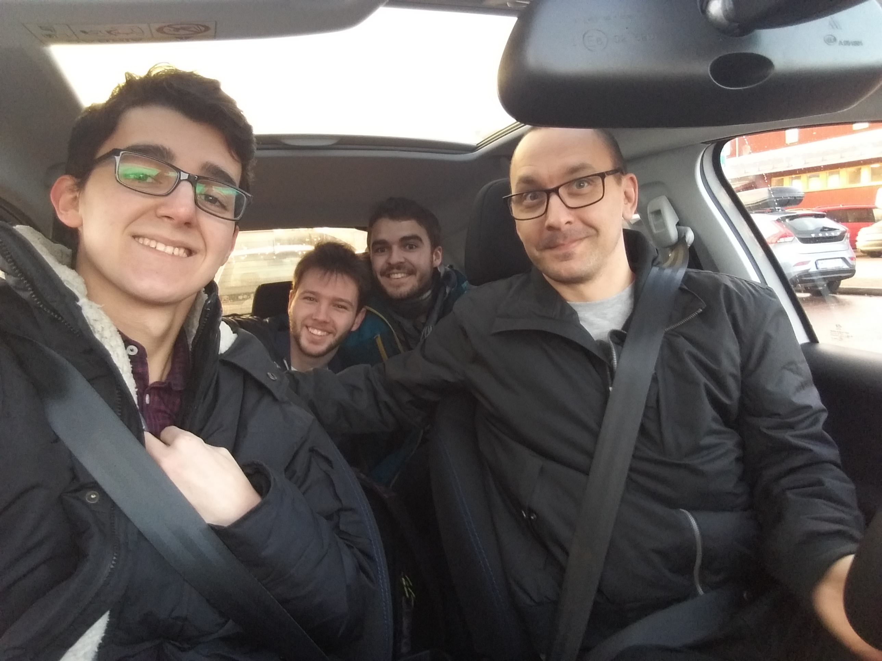
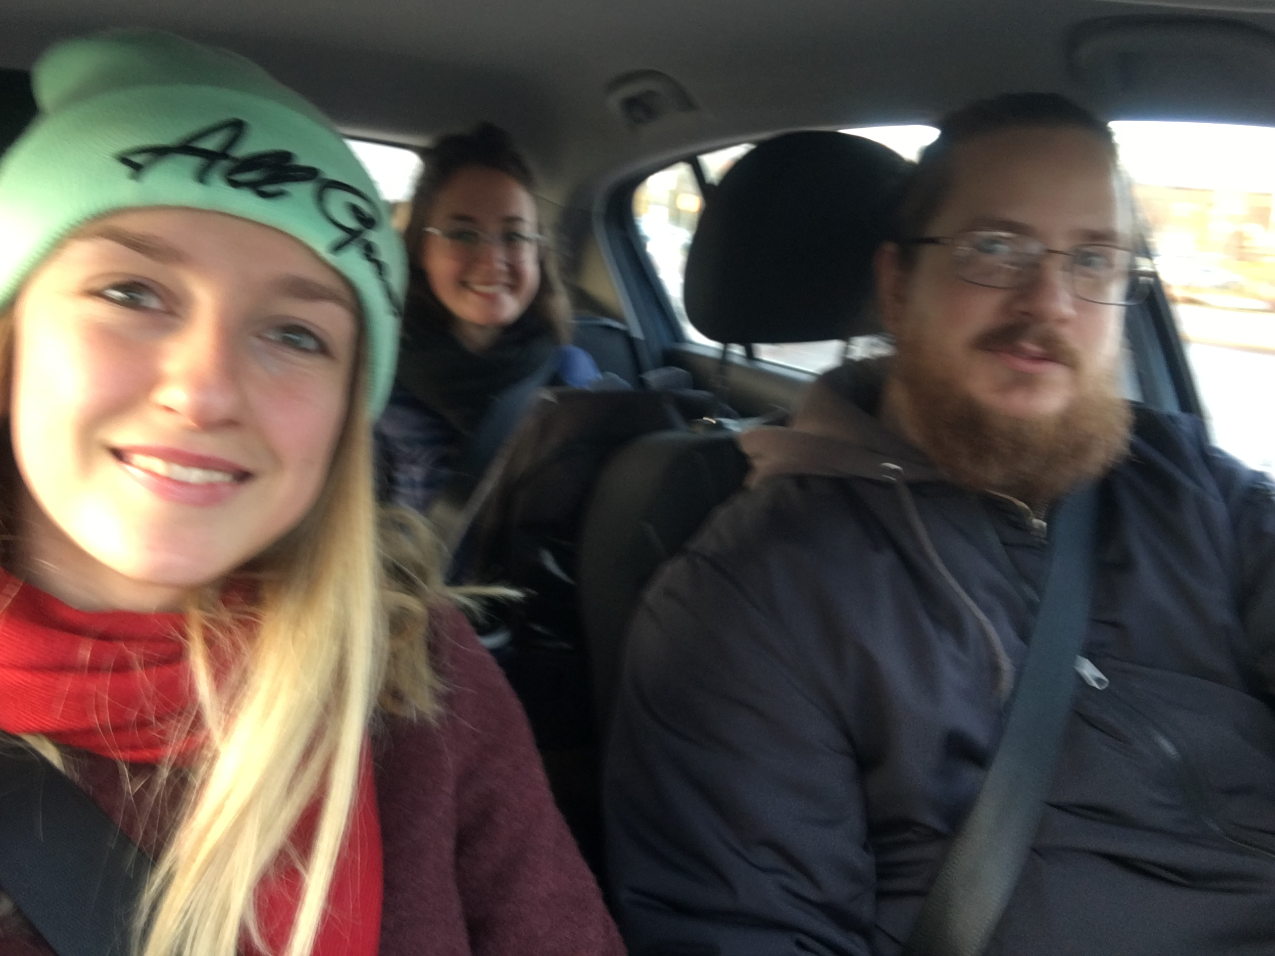
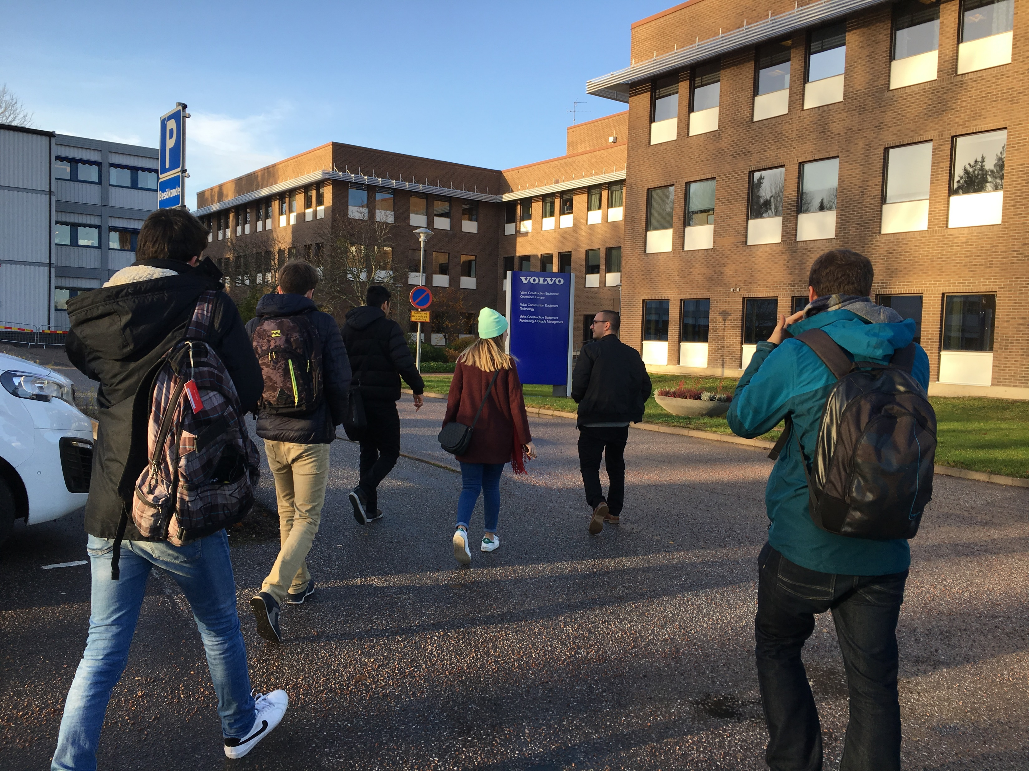
Client meeting

Slide 23
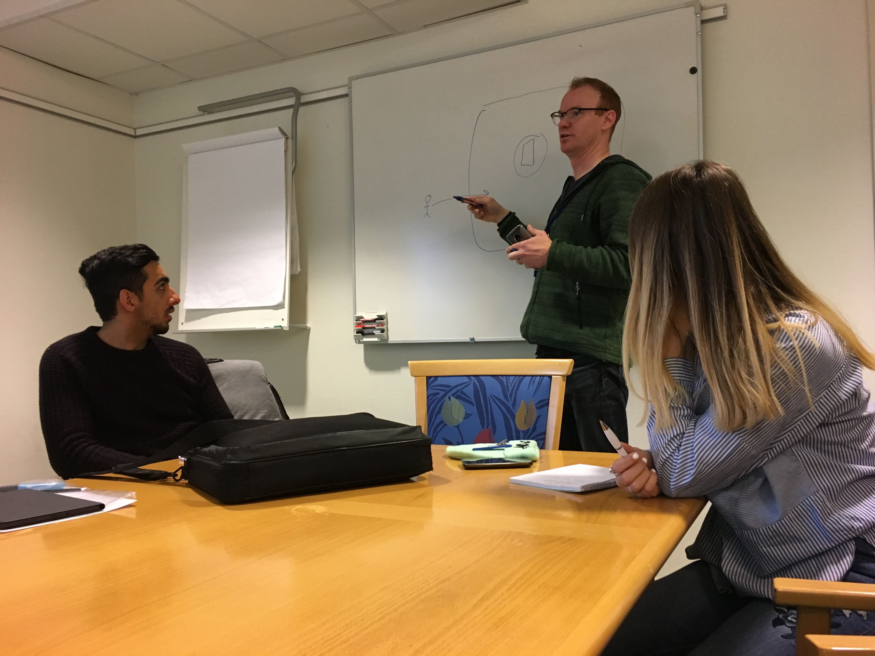
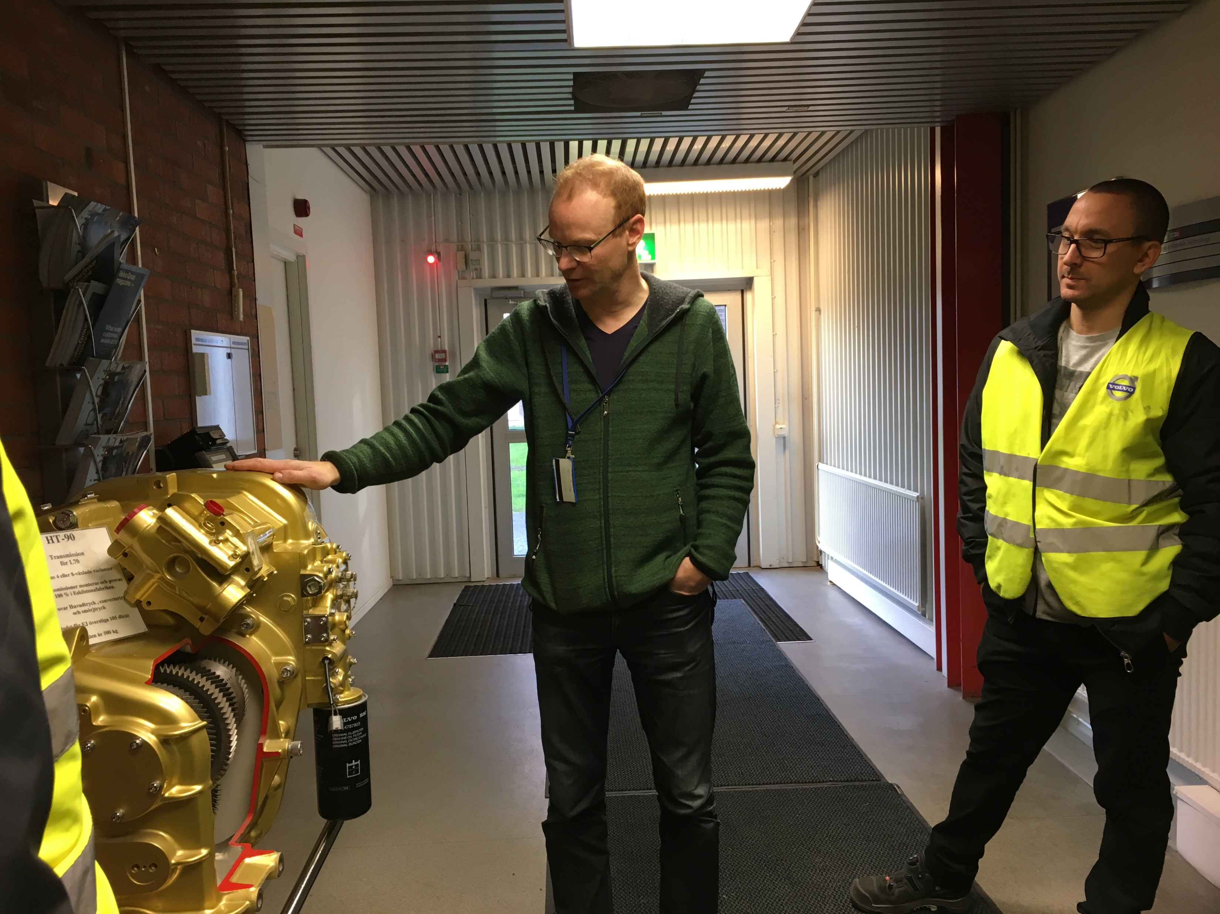
Client meeting

Slide 24
Client meeting
Many questions…
Very strict requirements vs Find a way to get a goal
Many devices vs Specific device
Plan-driven vs Agile
No interaction vs Lots of interaction
GPS vs Bluetooth
…

Slide 25

System description

Slide 26
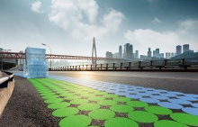

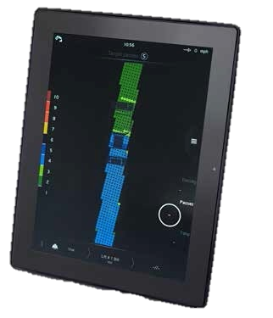
System description

Slide 27
Client meeting
Many questions…
Very strict requirements vs Find a way to get a goal
Many devices vs Specific device
Plan-driven vs Agile
No interaction vs Lots of interaction
GPS vs Bluetooth
…

Slide 28

Client meeting
Many questions…
Very strict requirements vs Find a way to get a goal
Many devices vs Specific device
Plan-driven vs Agile
No interaction vs Lots of interaction
GPS vs Bluetooth
…

Slide 29
System description
Safe Assist
It’s a way to avoid construction accidents while using heavy machines

Slide 30
System description
Safe Assist
It’s a way to avoid construction accidents while using heavy machines
There is a defined area with coordinates which is considered the construction area

Slide 31
System description
Safe Assist
It’s a way to avoid construction accidents while using heavy machines
There is a defined area with coordinates which is considered the construction area
Has information about the position of both operators & machines within the area

Slide 32
Client meeting
Many questions…
Very strict requirements vs Find a way to get a goal
Many devices vs Specific device
Plan-driven vs Agile
No interaction vs Lots of interaction
GPS vs Bluetooth
…

Slide 33
Client meeting
Many questions…
Very strict requirements vs Find a way to get a goal
Many devices vs Specific device
Plan-driven vs Agile
No interaction vs Lots of interaction
GPS vs Bluetooth
…

Slide 34
System description
Safe Assist
It’s a way to avoid construction accidents while using heavy machines
There is a defined area with coordinates which is considered the construction area
Has information about the position of both operators & machines within the area
Issues an alarm & notifies when a machine and a non-driver operator are to close
Notes:
blsablbaslblasnlbsjehfkjr

Slide 35
Client meeting
Many questions…
Very strict requirements vs Find a way to get a goal
Many devices vs Specific device
Plan-driven vs Agile
No interaction vs Lots of interaction
GPS vs Bluetooth
…

Slide 36
Client meeting
Many questions…
Very strict requirements vs Find a way to get a goal
Many devices vs Specific device
Plan-driven vs Agile
No interaction vs Lots of interaction
GPS vs Bluetooth
…

Slide 37
Client meeting
Many questions…
Very strict requirements vs Find a way to get a goal
Many devices vs Specific device
Plan-driven vs Agile
No interaction vs Lots of interaction
GPS vs Bluetooth
…
Updates with progress from time to time and feedback from him

Slide 38
Client meeting
Many questions…
Very strict requirements vs Find a way to get a goal
Many devices vs Specific device
Plan-driven vs Agile
No interaction vs Lots of interaction
GPS vs Bluetooth
…
RESEARCH ABOUT THE BEST WAY TO DO IT

Slide 39







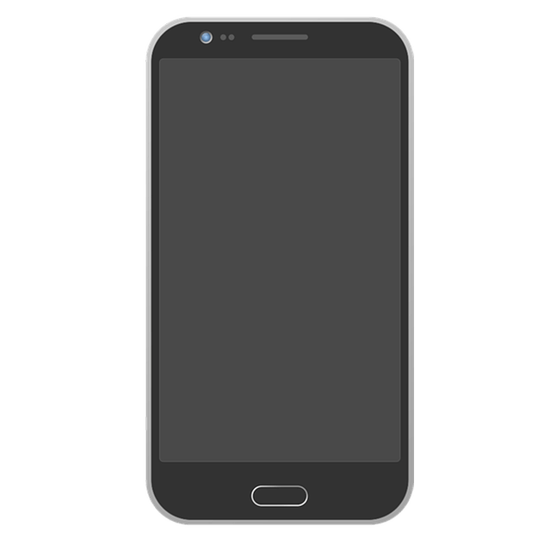
Research time!

Slide 40
Resources
What will we use?
Server database
Server communication
Android app (notifications, background execution)
GPS

Slide 41
Client meeting
Many questions…
Very strict requirements vs Find a way to get a goal
Many devices vs Specific device
Plan-driven vs Agile
No interaction vs Lots of interaction
GPS vs Bluetooth
…

Slide 42



Client meeting

Slide 43

Initial Backlog
Register worker
Warn the workers
Register vehicles
Associate worker with machines
Identify unit
Send location
Set construction sites

Slide 44
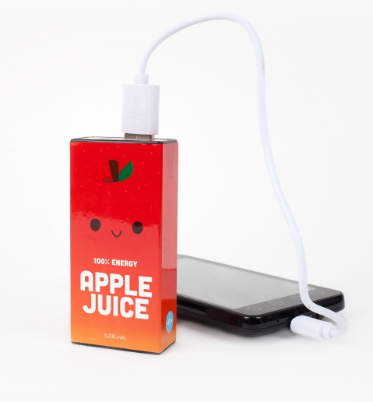
Non-functional Requirement
Quick to update location
Save as much juice as possible
Large views for each element of the CoPilot app
High visual contrast

Slide 45
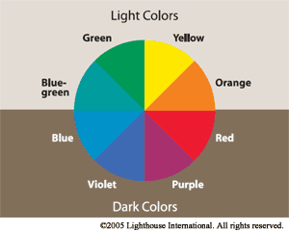
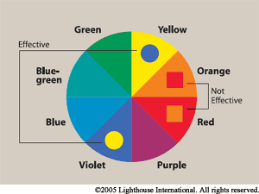


Slide 46
Thank you!

Slide 47


Slide 48
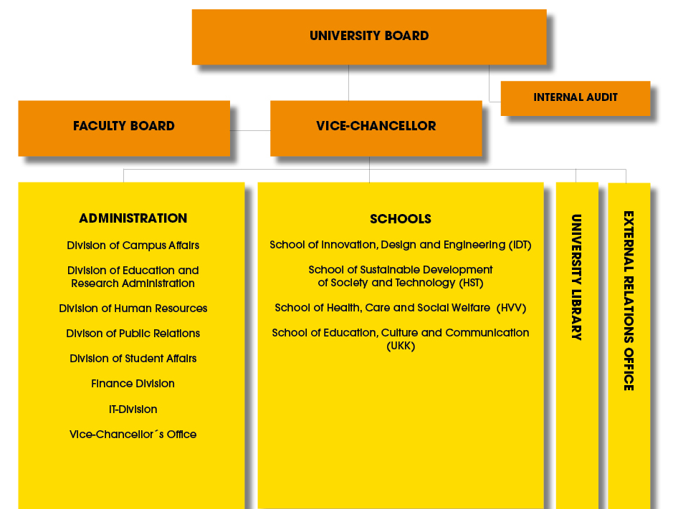
School of Innovation, Design and Engineering – IDT

Slide 49
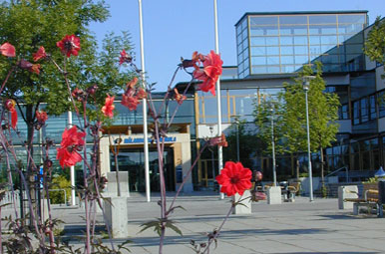
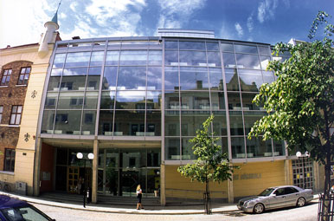
IDT subjects
Västerås
Eskilstuna
Embedded Systems
Software Engineering
Robotics / Electronic
Aeronautical Engineering
Information Design
Innovation Technology
Mechanical Engineering
Product- and process development

Slide 50





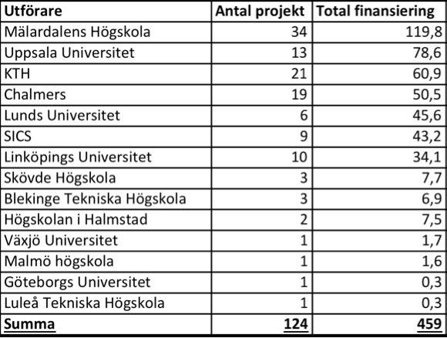
Research excellence
Industrial research schools:
CUGS 2001-2006
SAVE IT 2004-2011
SWELL 2006 – 2010
Hi5 2007-2011
ITS EASY 2011-2017
INNOFACTURE 2012-2018
Erasmus Mundus projects
EURECA
IDEAS
EUROWEB
”World Leading”
2010 Multiproject grant + 2 project grants
2009 Multiproject grant (best evaluation)
2008 the highest number of grants in CS
Best in Computer Science
National Strategic Research Centre for Embedded Systems
Stiftelsen för Strategisk Forskning
”Outstanding”
Academic strength
”Best in Sweden”
Evaluation of KKS profiles
Research in SE/ES 2005-2010
Awards and achievements
Future research leader award
Best Intern award
CAV Award for outstanding contribution in Computer Aided Verification
Preferred Research Partner within Volvo Group Academic Partner Program (APP)
MSEK

Slide 51
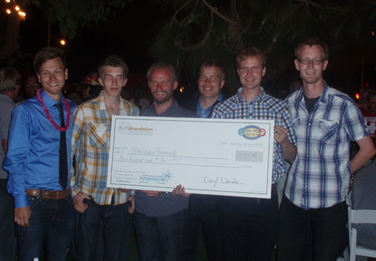
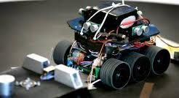


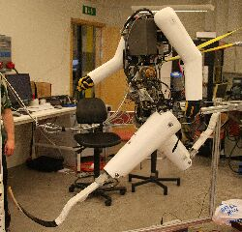
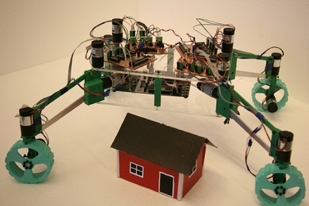
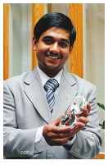
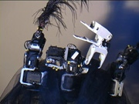
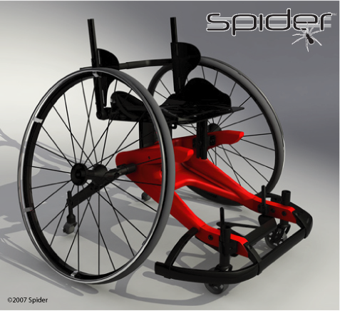
Education excellence
Student achievements
1st prize (twice!) at the international SCORE competition in Software Engineering
1st prize at the Design Open national competition
2nd and 3rd prize at Robot-SM national competition
Best craftship at RoboSub 2012 in San Diego
Plastic Innovation of the Year prize
Patent and production in Kina as a result of a master thesis in Innovation and Product design.
IDT alumnus design jewellery for Jean Paul Gaultier
Several Best Master Thesis awards
Nominated for Swedish Embedded Award 2011
Publications at prime conferences
Recruitment from master to PhD studies
…

Slide 52
Where does the success come from?
Young university – MDH was founded in 1977…
IDT was founded by few enthusiastic persons, all having long industrial background....
First courses developed together with a company ABB
Since then, many activities have been strongly linked to the industry from the very beginning…
Co-production is the key word!
Joint Need-Value-Benefit

Slide 53
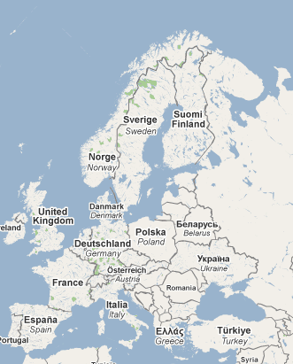
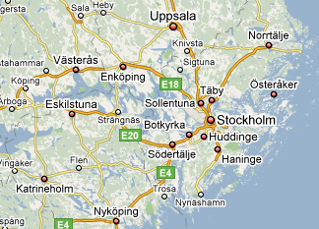


Large industrial cooperation
Mälaren Lake area
MDH is located in the expansive Mälardalen region with many large international companies around, such as:

Slide 54
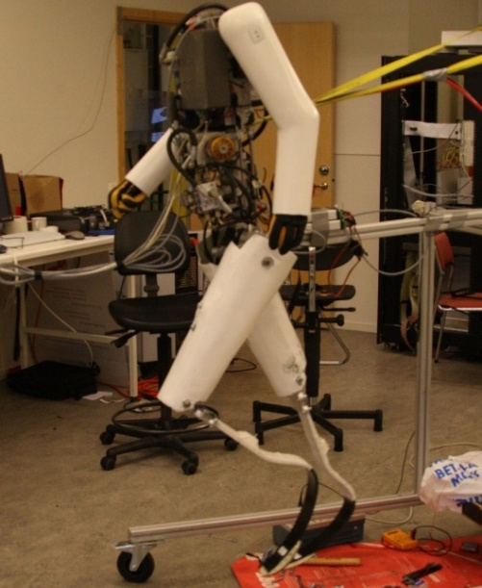
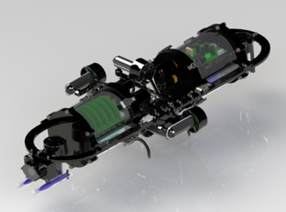
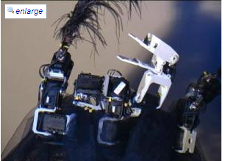
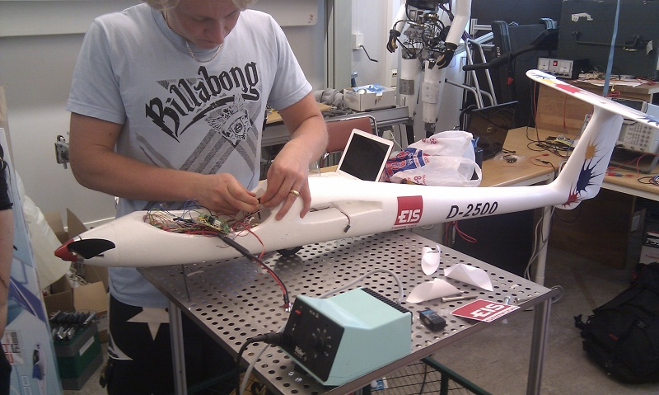
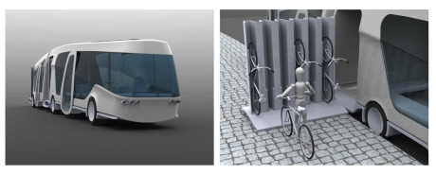
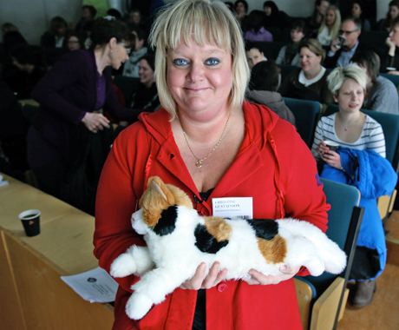
Industrial student projects and internships
Sprinter robot Dasher
Autonomous Underwater Vehicle
Sport wheelchair Spider
Dying Swan robot
Internships at companies
(with payment)
UAV
RoboCat
ECOBUS
Orwar- the energy monster

Slide 55
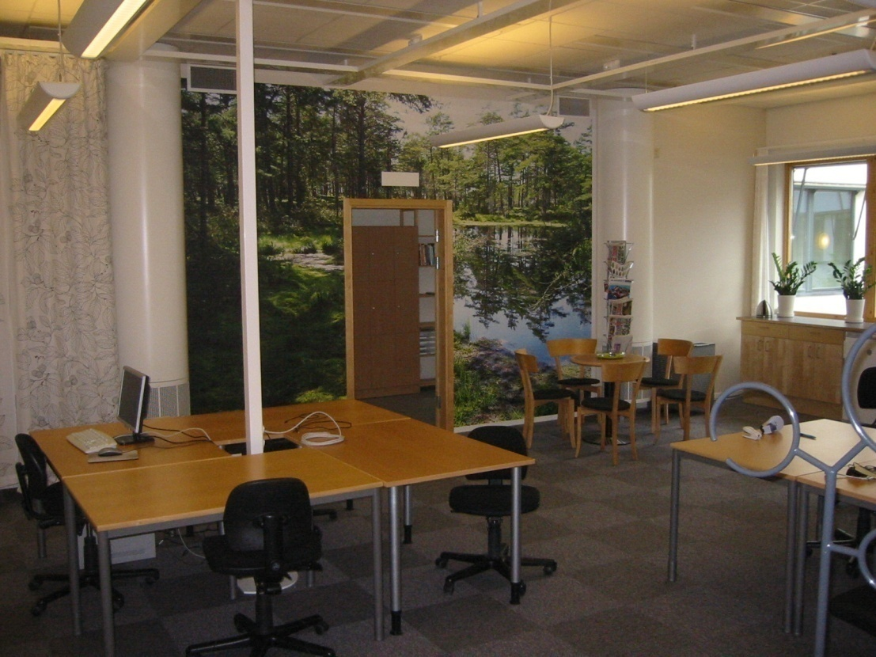
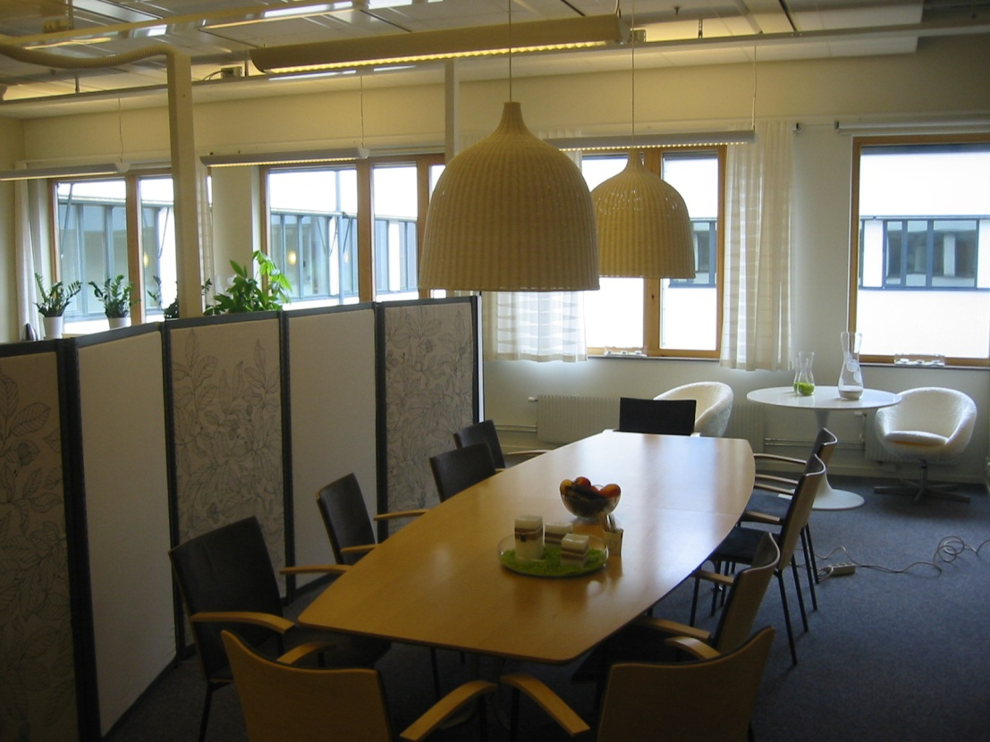
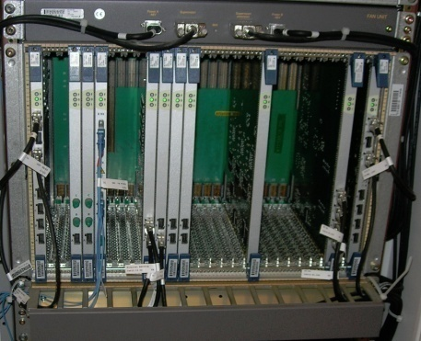
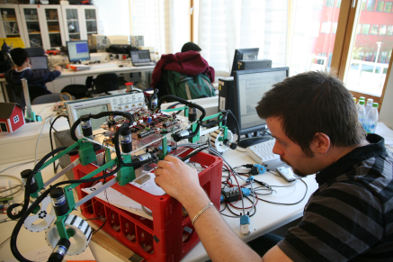
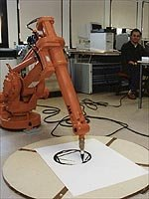
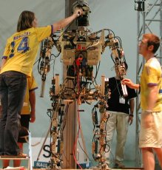
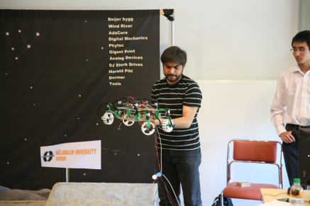
Joint industrial labs (at MDH)
Industrial Research and Innovation Lab (Ericsson)
Robotic Lab (several companies involved)

Slide 56
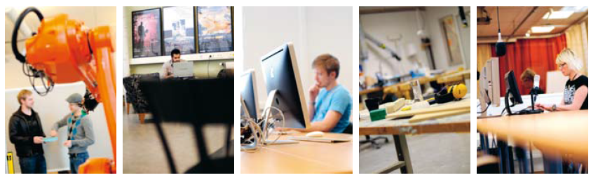
Coproduction platforms in Eskilstuna
MITC
Meeting places - Centrumrummet
- Studion
- Innovationsgym
Prototype lab with 3D-printing
XPRES-labb
Robot applications with MSP
Metal- and wood workshops
MUX-lab
- Mälardalen User Experience Lab

Slide 57
International master programs
Three international master programs closely related to our research (all given in English):
Master program in Software Engineering
1 or 2 years
Double-degree possibility (GSEEM)
Master program in Intelligent Embedded Systems
1 or 2 years
One semester abroad, double-degree
Master program in Product and Process Development – Production and Logistics
2 years

Slide 58
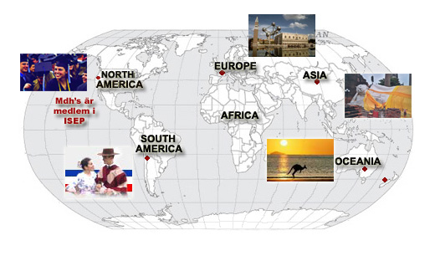
Education – International cooperation
Europe
Austria, Spain, Italy, England, France, Germany, Denmark, Finland, Croatia, Bulgaria, Czech Republic, Estonia, Greece, Hungary, Lithuania, Netherlands, Portugal, Poland, Ukraine,…
Asia
China, India, Japan, Thailand,…
Australia
North and South America
USA, Canada, Brasil,…
About 60 courses given in English, where international students attend classes together with Swedish students
More than 300 new international students at IDT every year.

Slide 59
Some practical issues…
Bologna system
1 academic year = 60 ECTS credits
2 semesters, Fall and Spring, 30 credits per semester
4 study periods, two per each semester
Course model
7.5 ECTS credits over 5 weeks or 15 credits over 10 weeks
Usually two courses run in parallel
Usually traditional classroom lectures and practical lab exercises
Strongly recommended to attend all lectures (in some cases mandatory, check with the course leader)
Usually final written exam at the end of the course

Slide 60
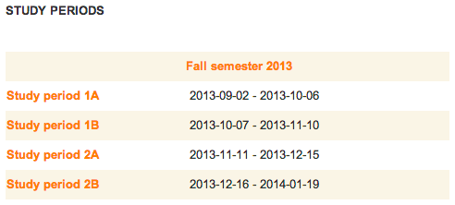
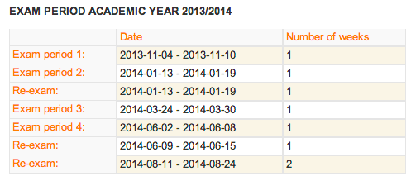
Academic calendar

Slide 61
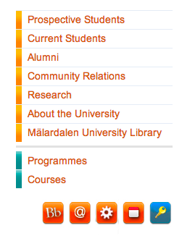
Some practical issues…
https://portal.mdh.se/student/
“Studentportalen” – Student portal
Information about your studies and useful web services, course schedules, study results, e-mail, current registrations for courses and study programs etc.
Use your student-ID login:
Course home pages
Course material, contact information, literature, syllabus,..
Created and maintained by teachers – can differ between courses
Can be found at:
Blackboard Learning System: http://mdh.blackboard.com/
IDT web server: http://www.idt.mdh.se/kurser/

Slide 62

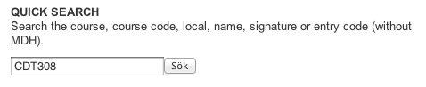
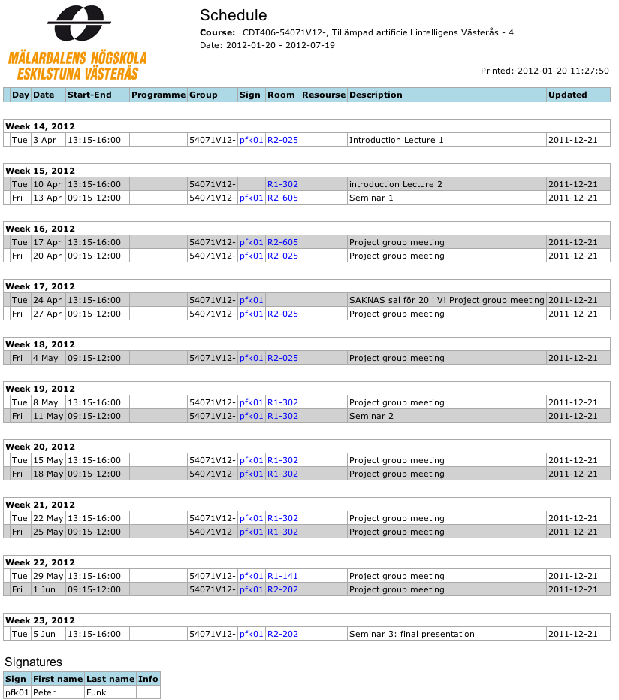
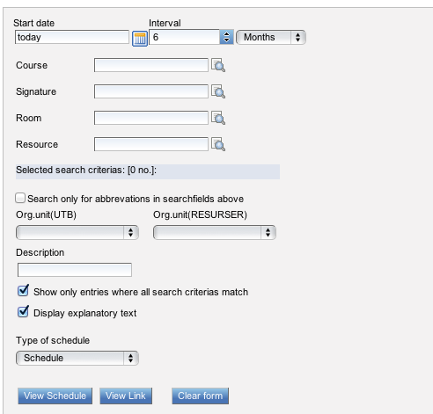
Some practical issues…
Course schedules
Advanced search

Slide 63
Some practical issues…
Examination
For each course, you must register for the final exam at least 10 calender days before the exam.
Registration for exams takes place online through Student portal.
Bring your student ID-card and for exchange students also your passport.
Don’t be late otherwise they will not let you in!
More info at: http://www.mdh.se/student/regler-rattigheter

Slide 64
Some practical issues…
Academic dishonesty
If cheating is suspected, it will be reported to the disciplinary committee for further processing. In case Academic dishonesty can be proved; the disciplinary committee will issue a warning or suspend the student for a time period.
Examples of cheating:
Plagiarizing; for example copying, paraphrasing and self-plagiarizing
Unauthorized co-operation
Joyriding or taking advantage
Fabrication
Un-authorized aids
More info at: http://www.mdh.se/hogskolan/organisation/namnder/disciplin

Slide 65
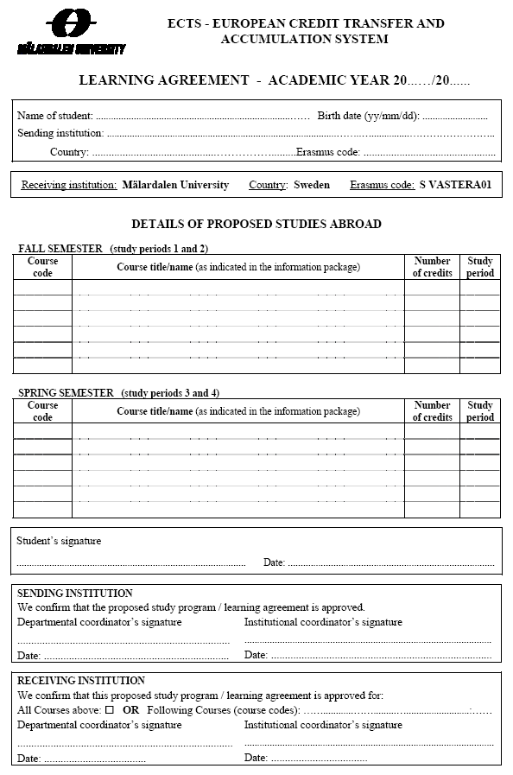
”Learning Agreement” for exchange students
An agreement about which courses you should take during your exchange studies.
The agreement should be signed by you and the international coordinators at MDH and your home university.
This agreement is the basis for the evaluation and registration of your studies on your return.
It is possible to update your Learning Agreement during your studies at MDH.

Slide 66
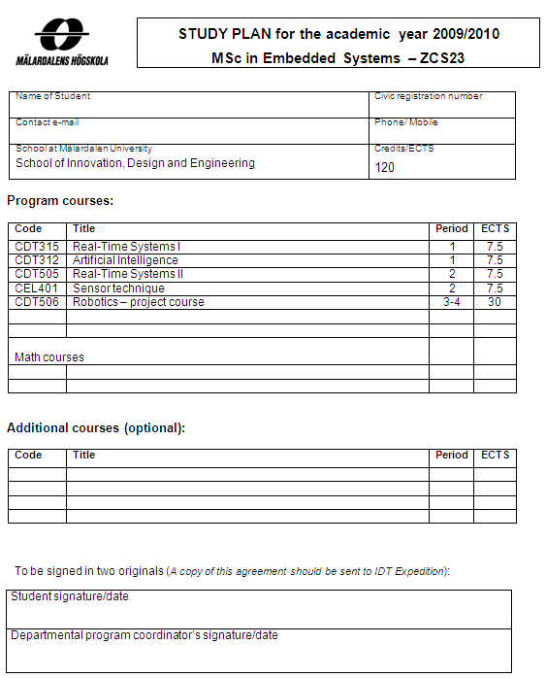
”Study Plan” for master students
An agreement about which courses you should take during one year of your master studies.
The agreement should be signed by you and the coordinator of your master program.
If you follow your Study Plan, you are guaranteed place on all included courses. Also, you are guaranteed correct degree upon competition of your studies.
It is possible to put additional courses to your Study Plan.

Slide 67


Contact information – Exchange students
International Study Councellor
Annika Björklund
E-mail: annika.bjorklund@mdh.se
Phone: 016-153276
International Coordinator
Dr Radu Dobrin
E-mail: radu.dobrin@mdh.se
Phone: 021-10 7356
Service desk
collect your exam results, ask for teachers, register for courses. There is a telephone outside the reception to reach teachers.

Slide 68



Contact information – Master students
MSc in Intelligent Embedded Systems
Moris Behnam, moris.behnam@mdh.se
Phone: +46 (0)21 10 7094
Room: U1-143 (Västerås)
MSc in Software Engineering
Sasikumar Punnekkat, sasikumar.punnekkat@mdh.se
Phone: +46 (0)21 10 7324
Room: U1-066c (Västerås)
MSc in Product and Process Development
Antii Salonen, antii.salonen@mdh.se
Phone: +46 (0)16-15 3606
Room: L372 (Eskilstuna)

Slide 69


Useful web sites…
www.studyinsweden.se
www.swedenintouch.se

Slide 70
Next steps – master students
Rool-calls
MSc Intelligent Embedded Systems
Monday, September 2nd at 15.00-16.00, room Kappa
MSc Software Engineering
Monday, September 2nd at 15.00-16.00, room U2-013
MSc Product and Process Development
Monday, September 2nd at 10.15-12.00, room L370

Slide 71
Next steps – Exchange students
ERASMUS, ISEP, bilateral
We have reserved some time for you this week, in case there are some unresolved issues with your Learning Agreement.
If you want to meet us, please put your name on the meeting list…

